Slide 1
Climate Exercise – Day 1
KATHARINE HAYHOE

Slide 2
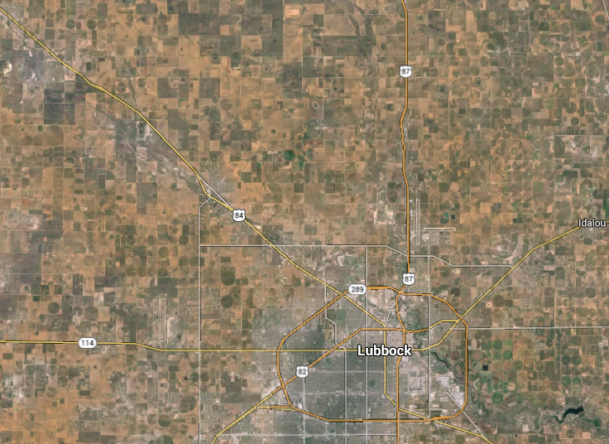

Slide 3
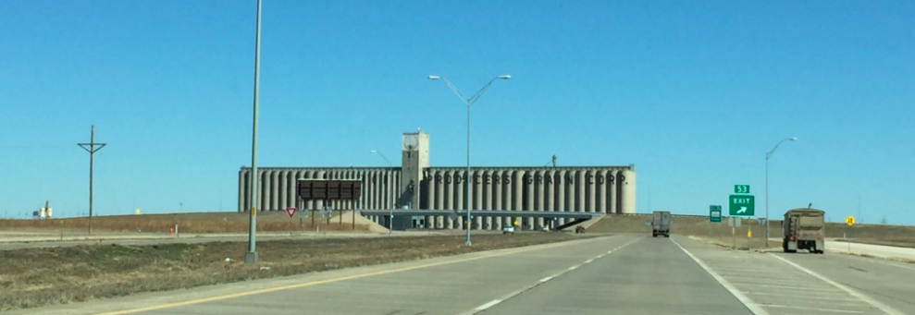
Planning for the future
based on the past
is like driving down the road looking in the rear-view mirror.

Slide 4
WHAT ARE INDICATORS?
Indicators are metrics that can be used to understand how climate conditions are changing.
We are using indicators based on maximum and minimum temperature and precipitation.
This code allows you to calculate three types of indicators:
Annual or seasonal averages
Days per year above or below a threshold
Record hot, cold, and wet conditions each year

Slide 5
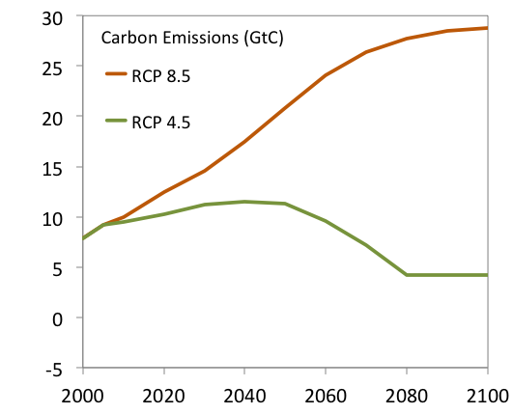
We calculate indicators for 2 futures
Notes:
Graphic: K. Hayhoe
Data: IIASA, available online at: http://www.iiasa.ac.at/web-apps/tnt/RcpDb/dsd?Action=htmlpage&page=compare
Fossil fuel photo: Phil Noble, available online at: http://planetark.org/wen/52587
Wind turbine photo: Chrishna, available online at: https://commons.wikimedia.org/wiki/File:Wind_turbines_on_blue_sky_with_clouds.jpg

Slide 6
THE STEPS FOR TODAY
STEP ONE: Open the statistical programming package R on your computer. Follow the instructions so the program knows where to find the directories it will need. The information you will need to enter should be written on the whiteboard here in the room.
STEPS TWO and THREE: Calculate climate indicators using two types of data: (1) weather station data for one of 64 different stations around India, and (2) gridded data covering all of India.
JUST FOLLOW THE INSTRUCTIONS
AND ASK FOR ASSISTANCE IF YOU NEED IT!

Slide 7
IF YOU HAVE TIME …
STEPS FOUR and FIVE: Plot the weather station projections using Excel, and plot the gridded data using a program called Panoply.

Slide 8
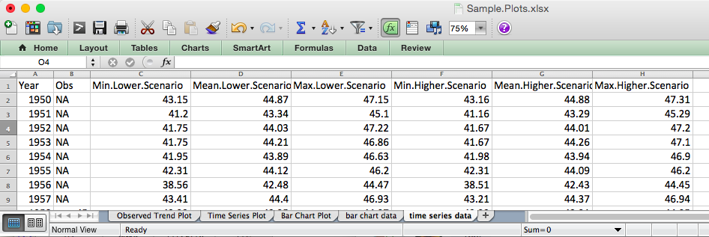
SAMPLE.PLOTS -> 3 TYPES OF EXCEL PLOTS

Slide 9
SAMPLE.PLOTS -> 3 TYPES OF EXCEL PLOTS

Slide 10
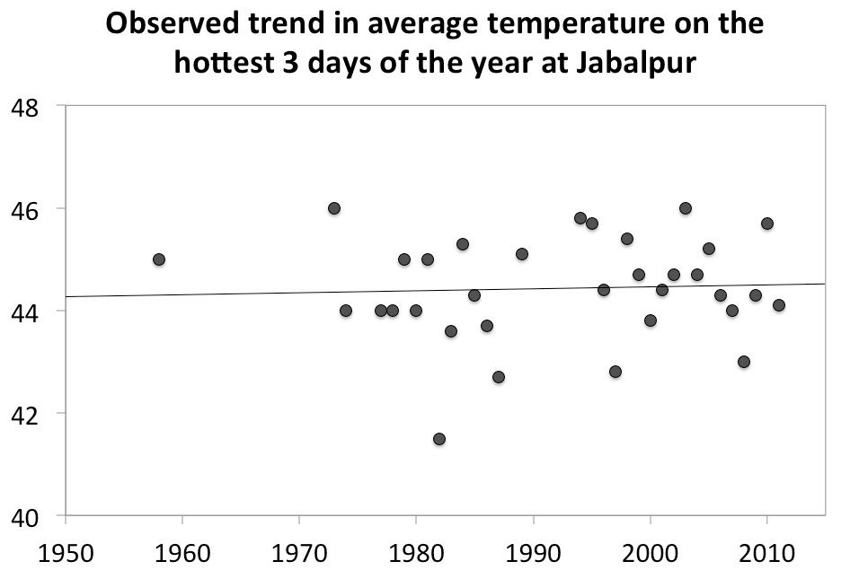
SAMPLE.PLOTS -> 3 TYPES OF EXCEL PLOTS

Slide 11
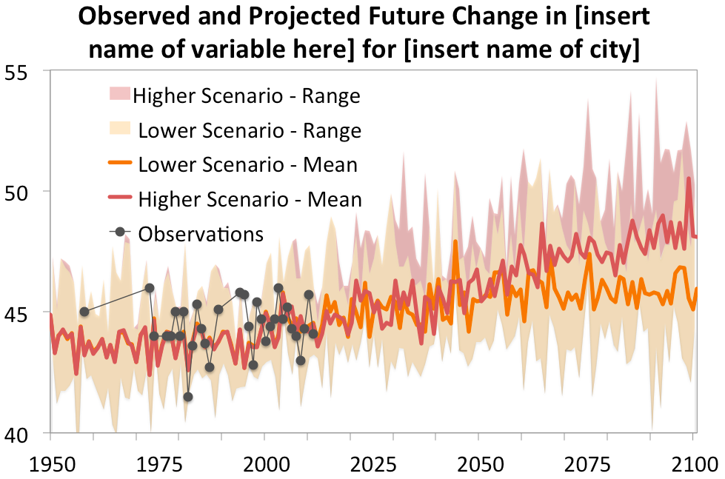
SAMPLE.PLOTS -> 3 TYPES OF EXCEL PLOTS

Slide 12
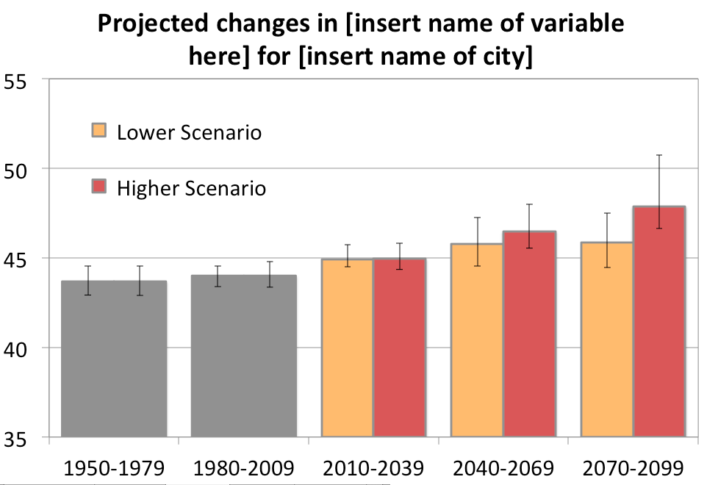
SAMPLE.PLOTS -> 3 TYPES OF EXCEL PLOTS

Slide 13
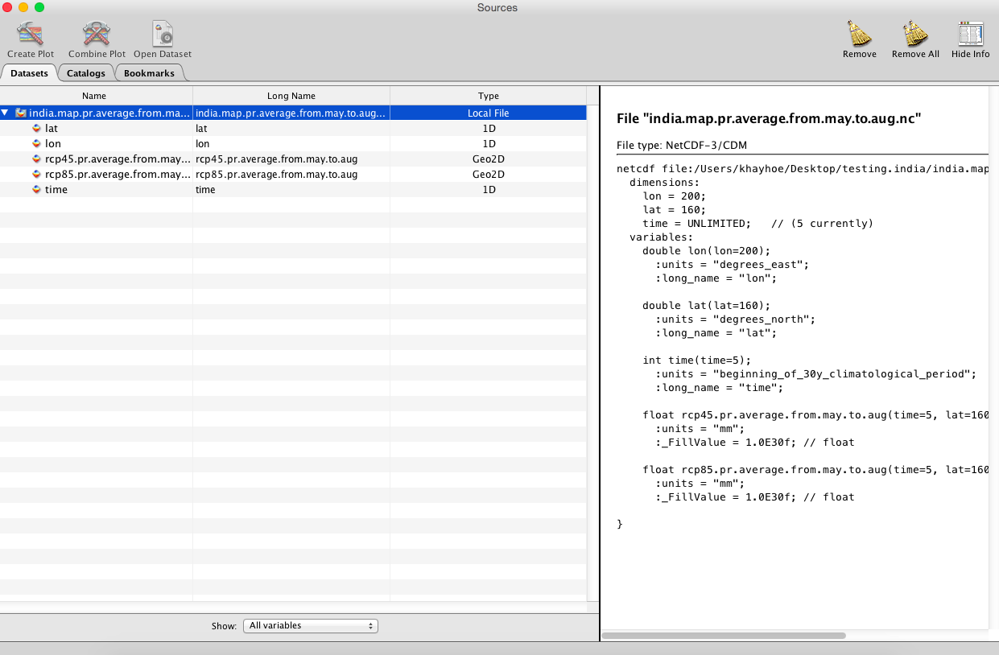
PANOPLY -> MAPS

Slide 14
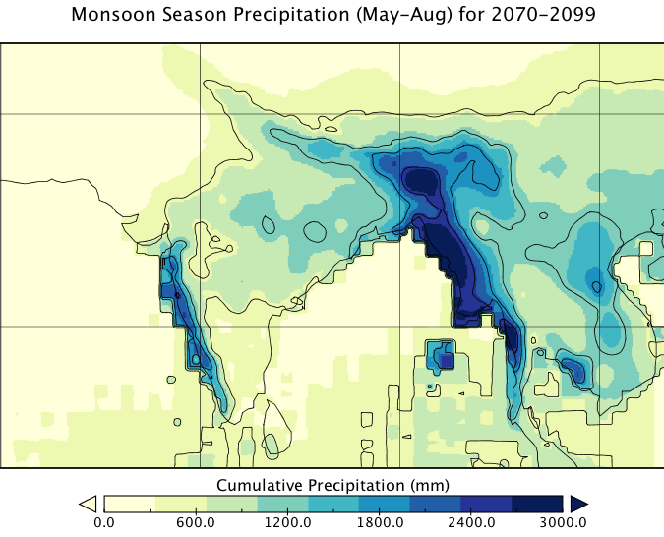
PANOPLY -> MAPS

Slide 15
IF YOU HAVE TIME …
STEPS FOUR and FIVE: Plot the weather station projections using Excel, and plot the gridded data using a program called Panoply.
STEPS SIX and SEVEN: Explore the differences between station data versus gridded data, and calculate many more indicators.

